Slide 1
Imagenet

Slide 2
Imagenet
The ImageNet dataset has more than 14 million images, hand-labeled across 20,000 categories.
The images in ImageNet are of decent resolution (224 x 224).
Processing a dataset of this size requires a large amount of computing power in terms of CPU, GPU, and RAM.
That might be too much for an everyday laptop. So what’s the alternative solution?
http://image-net.org/

Slide 3
Imagenette
Fast.ai’s Imagenette dataset is extracted from the large ImageNet collection of images.
Imagenette exists so that students and researchers can practice on ImageNet level images without needing large compute resources.
“I (Jeremy Howard, that is) mainly made Imagenette because I wanted a small vision dataset I could use to quickly see if my algorithm ideas might have a chance of working. They normally don’t, but testing them on Imagenet takes a really long time for me to find that out, especially because I’m interested in algorithms that perform particularly well at the end of training. But I think this can be a useful dataset for others as well.”
Jeremy Howard Jeremy is a founding researcher at fast.ai, a research institute dedicated to making deep learning more accessible.
https://github.com/fastai/imagenette

Slide 4
https://s3.amazonaws.com/fast-ai-imageclas/imagenette2.tgz

Slide 5
Image map
"n01440764" : “tench",
"n02102040" : "springer",
"n02979186" : "casette_player",
"n03000684" : "chain_saw",
"n03028079" : "church",
"n03394916" : "French_horn",
"n03417042" : "garbage_truck",
"n03425413" : "gas_pump",
"n03445777" : "golf_ball",
"n03888257" : "parachute"

Slide 6
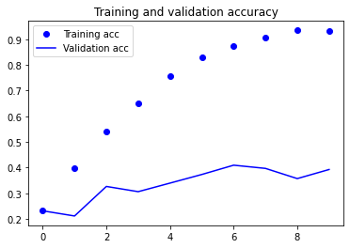
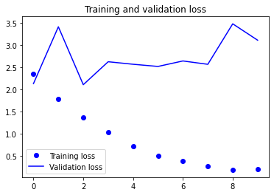
Simple network performance
Time required for training: 0:35:40.356834
Epoch 10/10 296/296 [==============================] - 233s 788ms/step - loss: 0.2285 - accuracy: 0.9259 - val_loss: 3.1173 - val_accuracy: 0.3924

